Slide 1
Web Services

Slide 2
Agenda
What are Web Services?
SOAP Web Services
RESTful Web Services
Service-Oriented Architecture

Slide 3
What are Web Services?
Remote applications need a way to talk to each other
Applications written on different platforms
Applications hosted at different locations
Web Services provide a way for one system to request data from another system
Web Services is how different applications ‘talk’ to each other
There are 2 main types (currently):
SOAP Web Services
RESTful Web Services

Slide 4
SOAP Web Services
SOAP: Simple Object Access Protocol
Based on XML and XSD definitions
3 main components:
WSDL: Web Service Descriptor Language
SOAP Envelope
UDDI: Universal Description, Discovery and Integration

Slide 5
SOAP envelope
This is the payload that is sent to the Web Service from the Client.
Contains details about which methods to invoke, and with what parameters.
E.g:
<?xml version="1.0" encoding="UTF-8"?>
<soapenv:Envelope xmlns:soapenv="http://schemas.xmlsoap.org/soap/envelope/" xmlns:xsd="http:// www.w3.org/2001/XMLSchema" xmlns:xsi="http://www.w3.org/2001/XMLSchema-instance">
<soapenv:Header> <RequesterCredentials xmlns="urn:ebay:apis:eBLBaseComponents" soapenv:mustUnderstand="0"> <eBayAuthToken>ABC...123</eBayAuthToken> <ns:Credentials xmlns:ns="urn:ebay:apis:eBLBaseComponents"> <ns:DevId>someDevId</ns:DevId> <ns:AppId>someAppId</ns:AppId> <ns:AuthCert>someAuthCert</ns:AuthCert> </ns:Credentials> </RequesterCredentials> </soapenv:Header>
<soapenv:Body> <GeteBayOfficialTimeRequest xmlns="urn:ebay:apis:eBLBaseComponents"> <ns1:Version xmlns:ns1="urn:ebay:apis:eBLBaseComponents">405</ns1:Version> </GeteBayOfficialTimeRequest>
</soapenv:Body>
</soapenv:Envelope>

Slide 6
Web Service Descriptor Language (WSDL)
Describes what methods are available on the web service, with what endpoints
E.g. http://developer.ebay.com/webservices/latest/ebaySvc.wsdl

Slide 7
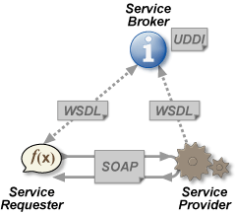
UDDI (Universal Description, Discovery and Integration)
A registry which lists down available web services for Universal Discovery.

Slide 8
RESTful web services
REST: REpresentational State Transfer
Every resource on the system has a URI
Details for every resource can be accessed via its unique URI
HTTP methods are used to accomplish functions:
GET – get details
POST – create new items
PUT – update items
DELETE – delete items

Slide 9
Calling a simple RESTful client
HTTP URLConnection class
Creates a connection and opens a channel to it
Accomplishes the same thing as a browser
There are other better implementations to call RESTful clients

Slide 10
Calling a simple RESTful client
Create a demo Redmine site at m.redmine.org
Enable RESTful services through admin and obtain an API key
Write up a class using URLConnection in Java
Set X-Redmine-API-Key header
Set up the URL object
Make the HTTP call

Slide 11
Bootstrapping a RESTful Web Service using Jersey

Slide 12
Jersey and JAX-RS
Jersey is a Java-based toolkit to build RESTful web services based on JAX-RS (Java API for RESTful Web Services)
It provides an easy methodology to build RESTful web services quickly and to deploy it on a container

Slide 13
Basic REST resource with Jersey
Grizzly container
Running HTTP GET
Returning text/plain media

Slide 14
JAX-WS
There are two ways to develop JAX-WS Web Services
RPC Style
Document Style
RPC Style
SOAP message is sent as many elements.
Tightly coupled.
SOAP message keeps the operation name.
RPC style web services use method name and parameters to generate XML structure.
In WSDL file, it doesn't specify the types details.

Slide 15
JAX-WS
Document Style
SOAP message is sent as a single document.
Loosely coupled.
SOAP message loses the operation name.
Document style web services can be validated against predefined schema.
In WSDL file, it specifies types details having namespace and schemaLocation.

Slide 16
Calling a simple Hello World using SOAP
Create HelloWorldServer interface which has sayHello() method which takes name parameter.
Create HelloWorldServerImpl which implements HelloWorldServer and its method sayHello(String name).
Create HelloWorldServerPublisher which will publish web service.
Create HelloWorldClient to consume hello world web service.
Wsdl created - http://127.0.0.1:9876/hw?wsdl

Slide 17
Service-Oriented Architecture (SOA)
New concept where all parts of a system are web services
Each module of a system connects to each other using web service client calls
Enables quick integration, fast access, and encapsulates and standardizes the modular communication process

Slide 18
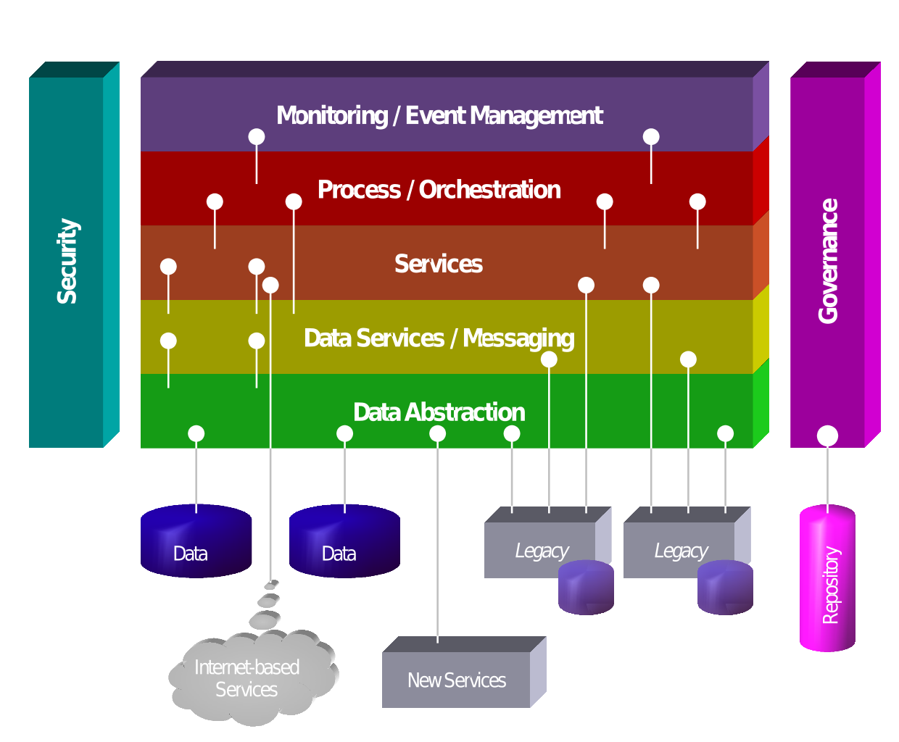
Service-Oriented Architecture (SOA)

Slide 19
Thank You!
if ( question != null && question != “” ) {
var answer = ask (question);
if ( answer != satisfactory) {
var betterAnswer = googleIt(question);
}
}

